Slide 1
AWS
Group Assignment by:
Nicolas Abadi
Adelina Bronda
Shana Charlery
Finn Macrae
Hifza Zaheer

Slide 2
Introduction
The general outline of this project was to use all the concepts learnt out to this point, design and implement a solution for automating the deployments and development workflows for the projects.
Deploying infrastructure including EKS Cluster and Jenkins Server via Terraform
Utilising Docker to build images based on the applications
Containerising applications via Kubernetes
Utilising Ansible for infrastructure configuration
Deploying Jenkins for CI/CD with Github Webhook integration

Slide 3
Planning
As this is a group project composed of 5 members, there will need to be adequate planning measures in place so that all individuals can work efficiently and coherently towards the main goal which is the successful deployment of the application.
Therefore, throughout the duration of this project we chose to employ Scrum as our project management framework.
To follow best practice within industry, we use a Kanban board to manage the project (Using Trello). The MoSCow Prioritisation Method has been used in order to identify key areas of development,

Slide 4
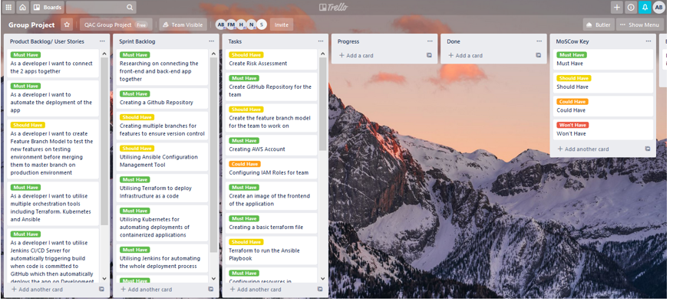
Product backlogs

Slide 5
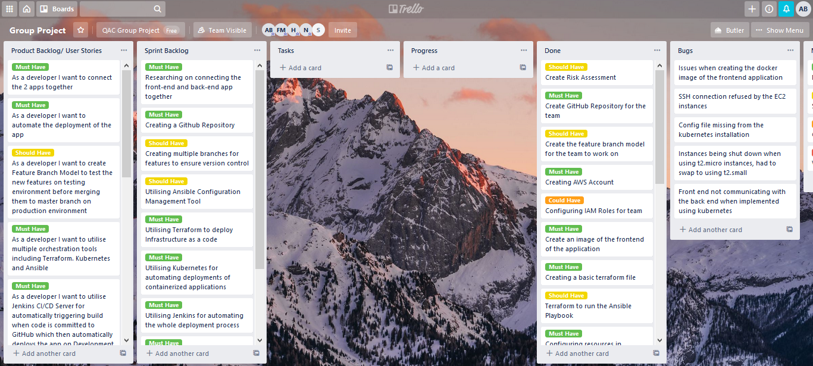
Done

Slide 6
Risk Analysis

Slide 7
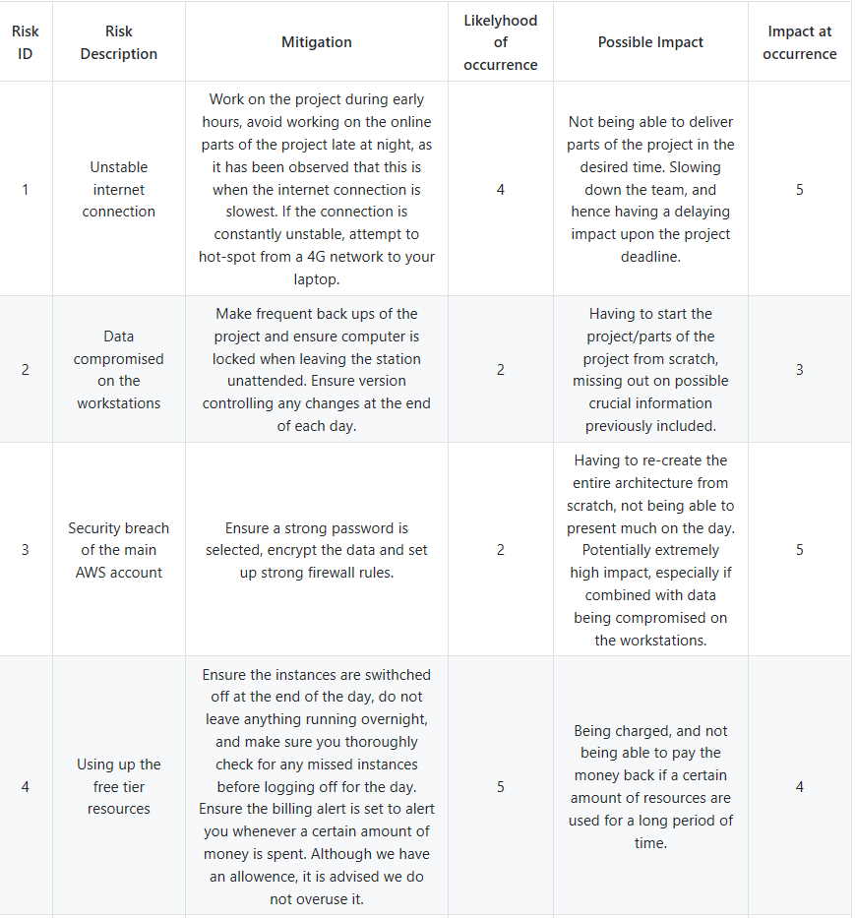
Initial Risk Analysis
The project started by creating an initial risk assessment as shown. As the project went on, new risks started appearing as well as current risks changing their likelihood of occurrence at it got closer to the end of the project.

Slide 8
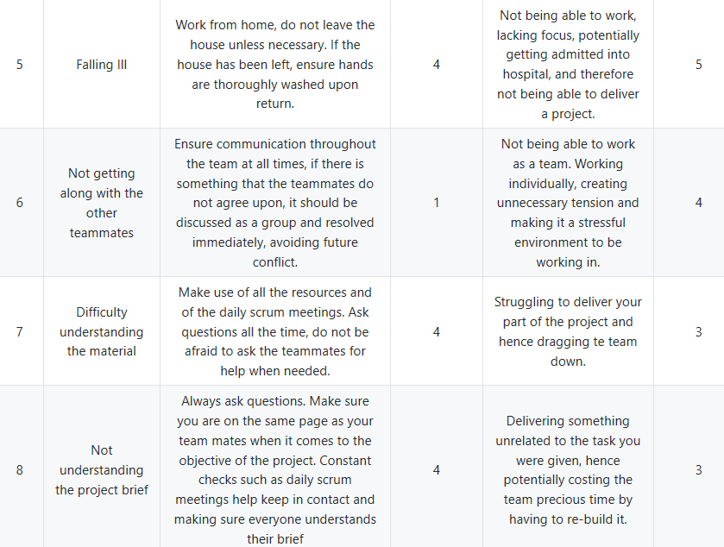
Initial Risk Analysis

Slide 9
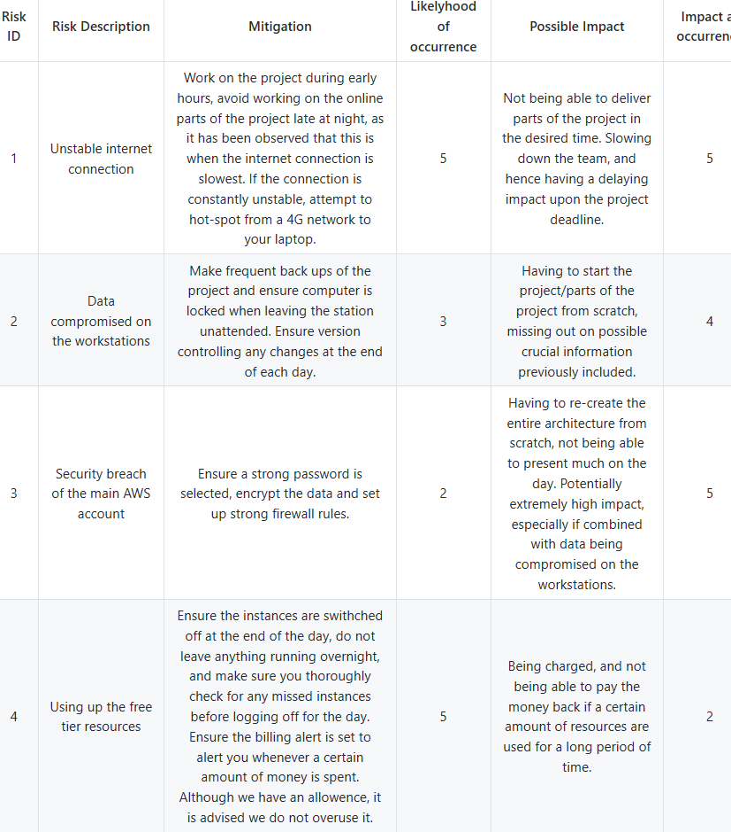
Final Risk Analysis

Slide 10
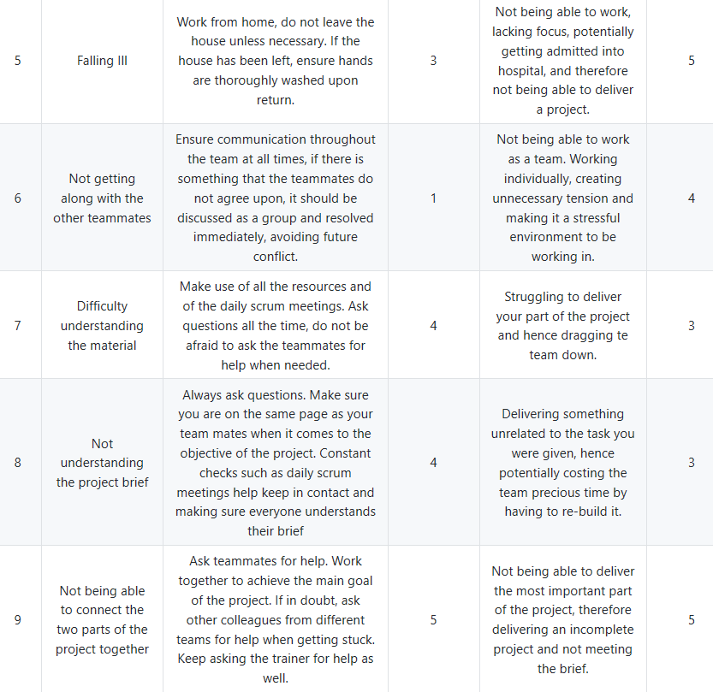
Final Risk Analysis

Slide 11
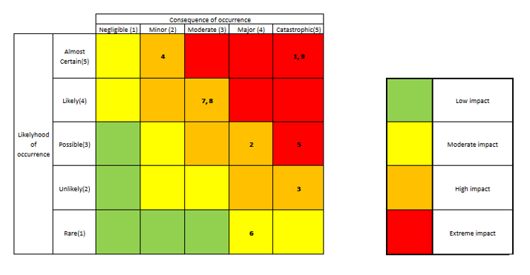
Risk Analysis Matrix
A risk matrix is a matrix that is used during the risk assessment process to define the level of risk by considering the category of probability or likelihood against the category of consequence severity. This is a simple mechanism to increase visibility of risks and assist management decision making.

Slide 12
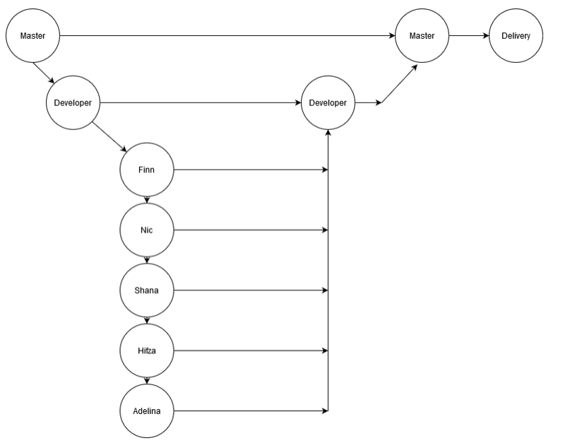
Branch Model

Slide 13
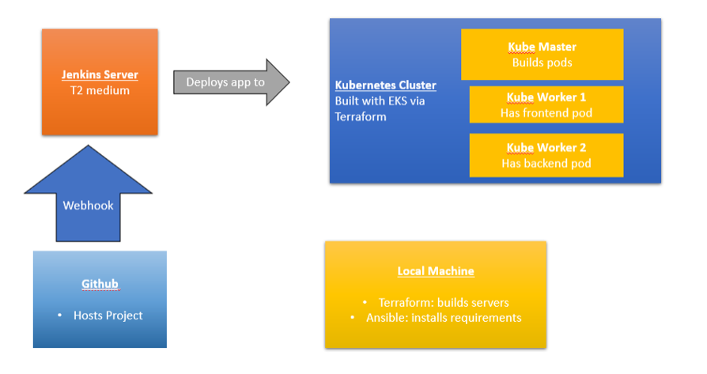
Environments

Slide 14
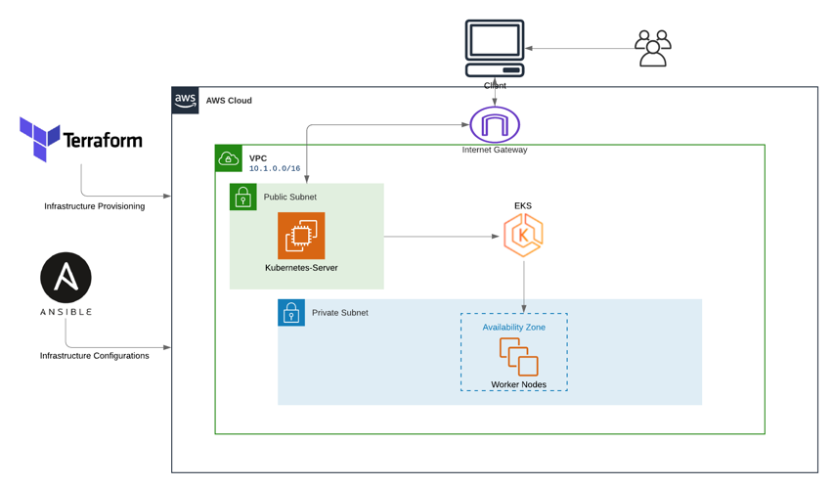
Environments

Slide 15
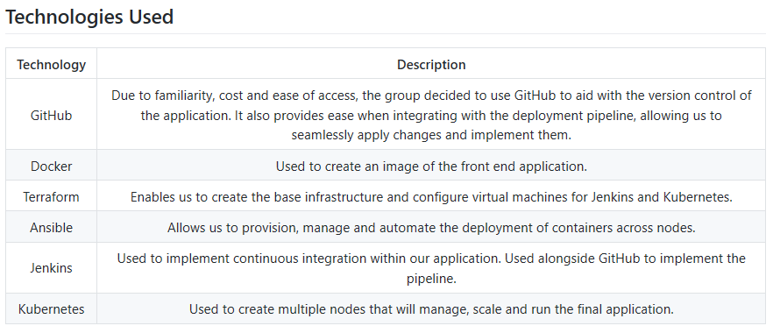
Architecture

Slide 16
Testing

Slide 17
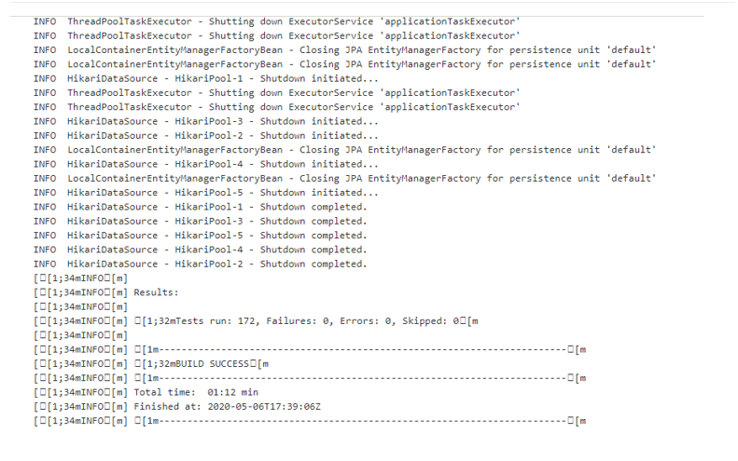
Backend Testing Logs

Slide 18
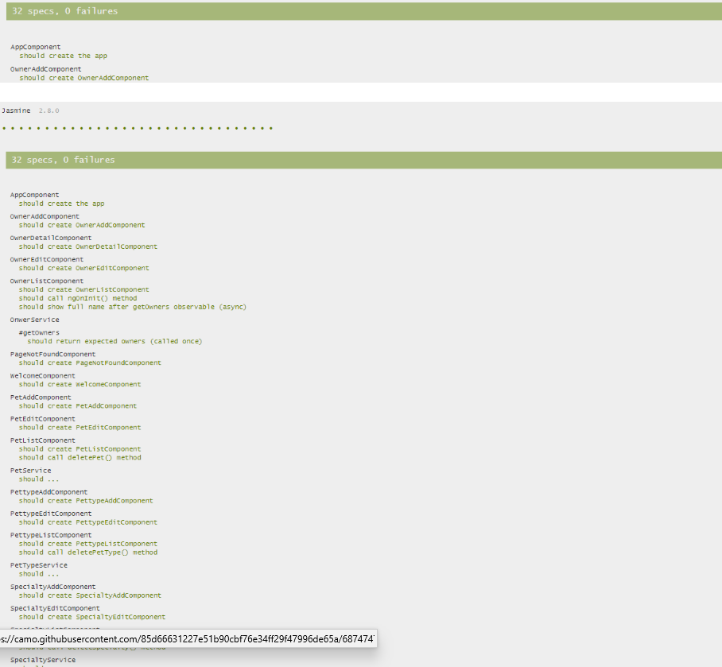
Frontend Testing Logs

Slide 19
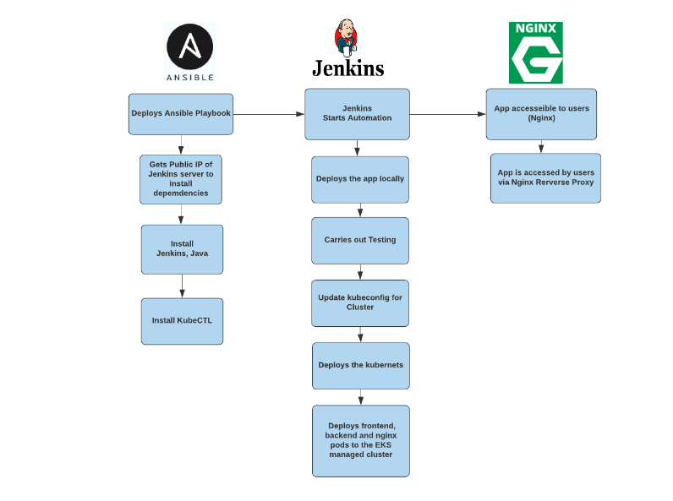
Deployment

Slide 20
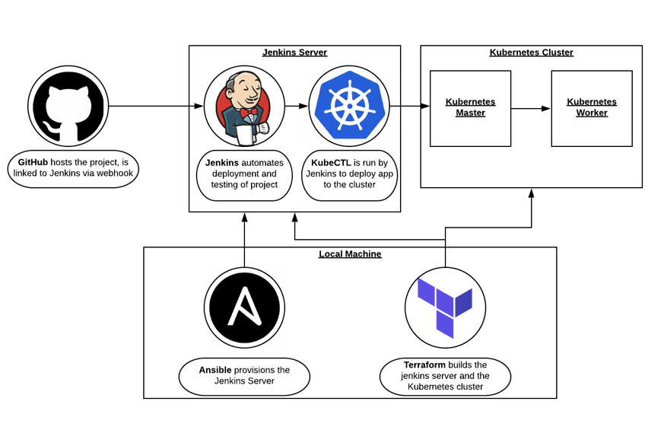
Deployment Pipeline

Slide 21
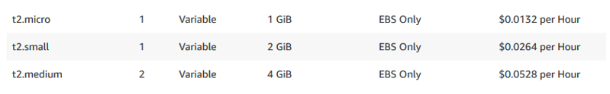
Costs

Slide 22
Retrospective
What went well
Using terraform to create the infrastructure went swiftly without many issues.
Team meetings were helpful and orientating.
Good team communication throughout the duration of the project.
Created the Ansible and Jenkins files without much difficulty.
Delivered a cost efficient solution.
What went wrong
Running the frontend application came with some issues that required the help of our trainer.
Creating the pods for the cluster took longer than expected.
Issues when using the AWS free tier service, so had to pay for running the simple Virtual Machines.
The backend and frontend of the application not communicating, wasted a lot of time on trying to fix the issue.

Slide 23
Future improvements
Add the CloudWatch alert.
Implement the Lambda function to take daily snapshots.
XRay to be implemented on the spring application so we can monitor the API level request.
CodePipeline as a serverless solution and replace Jenkins.

Slide 24
Demo

Slide 25
Thank you &
any Questions?

